Slide 1
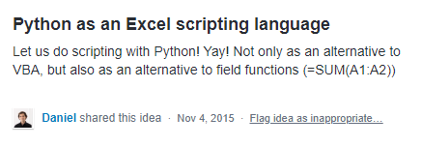
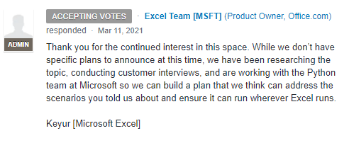
how it started how it’s going

Slide 2
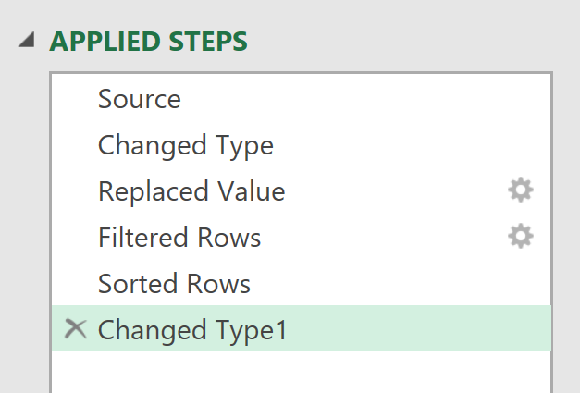
EVERY STEP YOU TAKE
I’LL BE WATCHING YOU

Slide 3
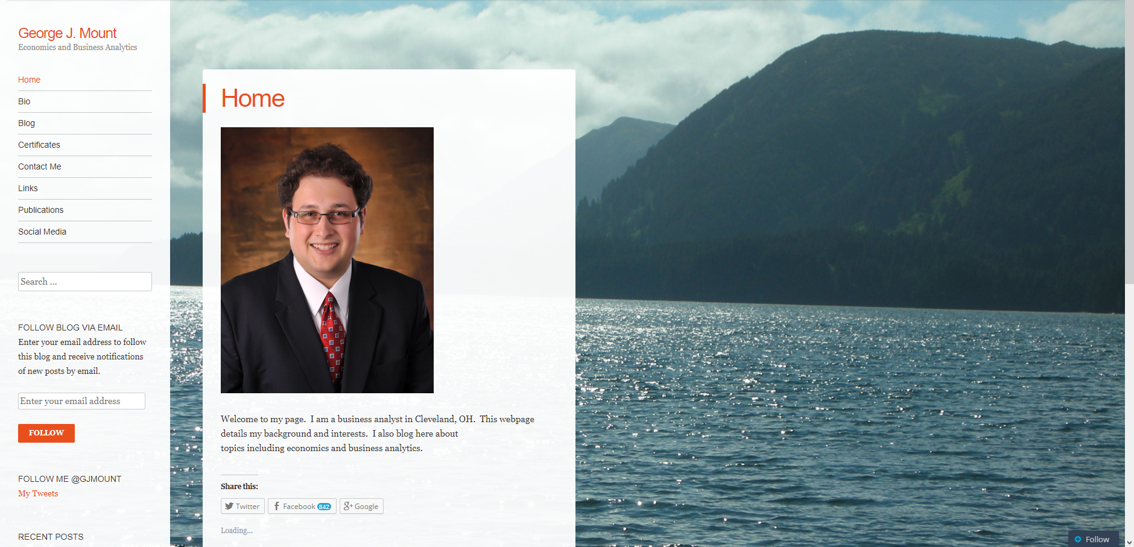
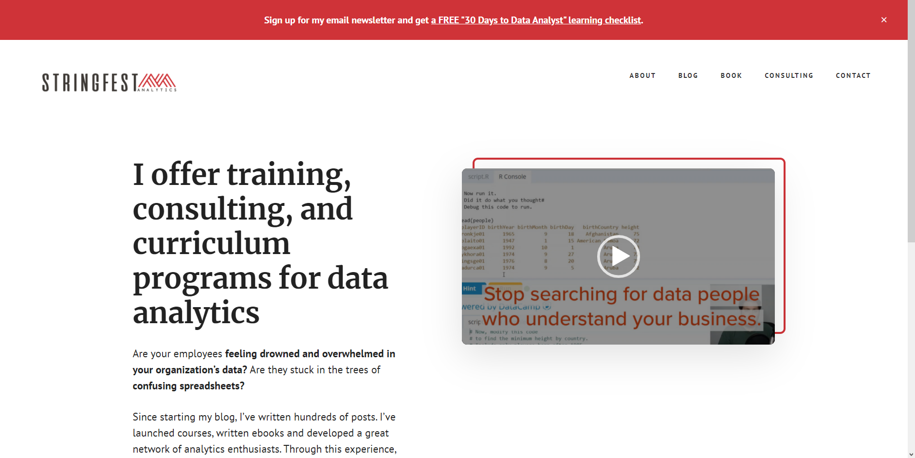
how it started
how it’s going

Slide 4

DATA ANALYSTS
R/PYTHON
R/PYTHON
R/PYTHON
ADVANCED ANALYTICS
REPRODUCIBLE PROJECTS
AUTOMATED TASKS
COMPELLING VISUALIZATIONS
HIGHER PAY

Slide 5


ANALYSTS
ACCOUNTANTS
MARKETERS
INVESTORS
TEACHERS
ENGINEERS
ECOLOGISTS
EVALUATORS
PHYSICIANS
ADMINISTRATORS

Slide 6


CLIPPY GETS HIS REVENGE

Slide 7

BI tool with limited statistical capabilities:
“Sure, we can do AI…”

Slide 8

When you search online to get help and your own post shows up

Slide 9
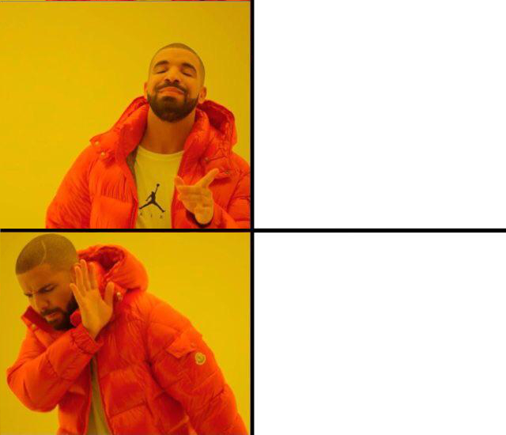
Working on a business project
Working on a business project with an upcoming deadline

Slide 10

